Slide 1
How to Fast
Matthew 6:16-18

Slide 2
How to Fast
Topic not many of us have lots of experience of
What fasting is or isn’t
How to and how NOT to fast
What does fasting achieve?

Slide 3
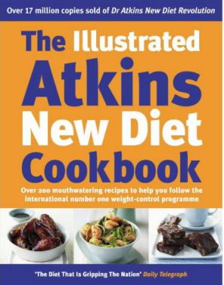
What Fasting isn’t
This is NOT what fasting is

Slide 4
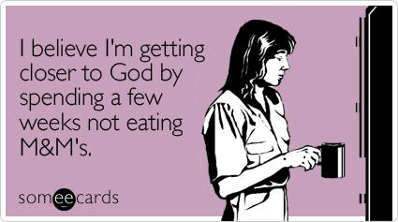
What Fasting isn’t
This is NOT what fasting is

Slide 6
What Fasting is
Is not this the fast that I choose: to loose the bonds of wickedness, to undo the straps of the yoke, to let the oppressed go free, and to break every yoke? Is it not to share your bread with the hungry and bring the homeless poor into your house; when you see the naked, to cover him, and not to hide yourself from your own flesh? Isaiah 58:6-7

Slide 7
What Fasting is
The conscious decision to refrain from food and / or water
AND
To adopt at the same time some practice to work for the expansion of the Kingdom of God
What does that mean in reality?

Slide 8
What to do when Fasting
Pray
When you’re hungry / when you would normally eat
For a specific purpose
As and when you are moved
Social Action
Sharing bread
Housing the homeless
Clothing the naked

Slide 9
What NOT to do when Fasting
We are NOT to tell others we are fasting
“When you fast, do not look somber as the hypocrites do, for they disfigure their faces to show others they are fasting.”
Indeed, we are told to make sure people don’t know we are fasting
“But when you fast, put oil on your head and wash your face, so that it will not be obvious to others that you are fasting”

Slide 10
What’s the point?
What does fasting achieve?
It’s not a box-ticking exercise
It’s not a magic formula
It’s not pointless

Slide 11
What’s the point?
Like all prayer, fasting is NOT a way to change God’s mind but rather a way to discern God’s mind
“Prayer, as a classical spiritual discipline, is primarily relational, not functional” Robert Mulholland Jr
The things we do during our fast should have a purpose
“Intention”

Slide 12
What’s the point?
There is no point in fasting without feasting
Feasting is not just eating, it is
Providing plenty when there was poverty
Celebrating the goodness of God’s creation
Expanding the knowledge of the generosity of God – ultimate generosity is the gift of his Son for our salvation
Liturgical Year helps structure fasting and feasting

Slide 13
So......
Have a go!
Decide an intention
Decide what you’re fasting from and why?
Decide what you’re going to do to build God’s kingdom
Decide what your feasting at the end will be
Do it!

