Slide 2
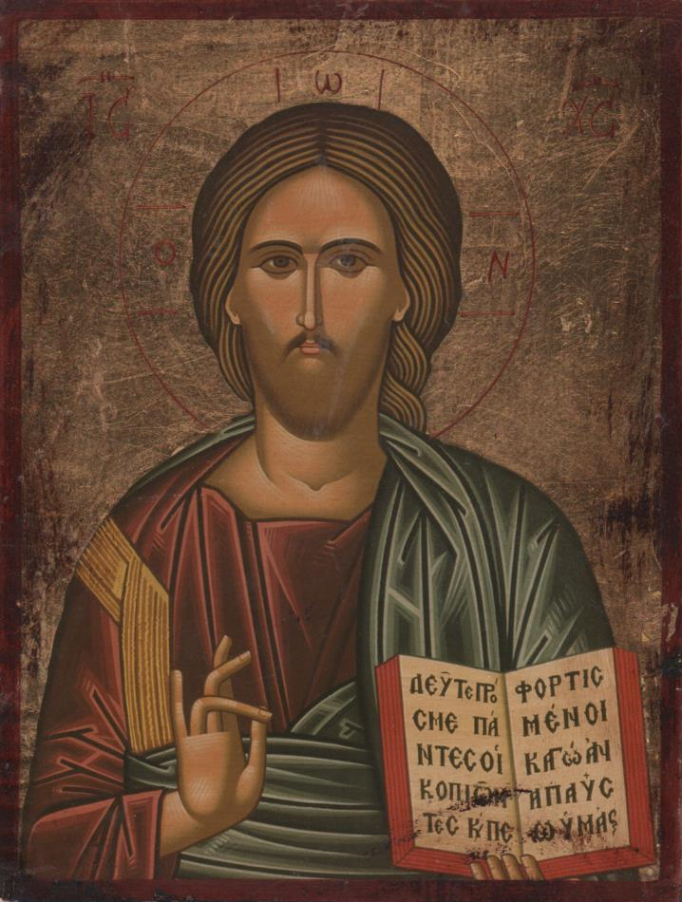

Slide 4
Genesis 1:27 | Genesis 2:23
So God created man in his own image | This at last is bone of my bones
in the image of God he created him | and flesh of my flesh;
male and female he created them | she shall be called Woman, because she was taken out of Man.

Slide 5
Theme | Serpent | Woman | Adam
Guilt | Because you have done this, |  | Because you have listened to the voice of your wife and have eaten of the tree of which I commanded you, “You shall not eat of it,”
Curse | cursed are you above all livestock and above all beasts of the field; on your belly you shall go, and dust you shall eat all the days of your life. |  | cursed is the ground because of you;
Sentence | I will put enmity between you and the woman, and between your offspring and her offspring; he shall bruise your head, and you shall bruise his heel. | I will surely multiply your pain in childbearing; in pain you shall bring forth children. Your desire shall be for your husband, and he shall rule over you. | in pain you shall eat of it all the days of your life; thorns and thistles it shall bring forth for you; and you shall eat the plants of the field. By the sweat of your face you shall eat bread, till you return to the ground, for out of it you were taken; for you are dust, and to dust you shall return.

